Slide 1
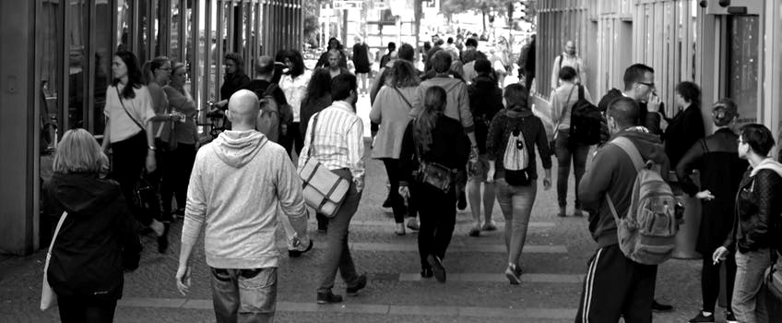
What is a community?
Starter – What do you think of when you hear the word community?

Slide 2
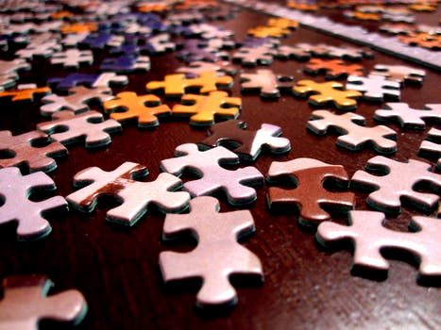
A and share group values who of people who in close common contact interests and are
A group of people who are in close contact and who share common interests and values.
Notes:
Students should work in small groups to try and work out the definition.

Slide 3
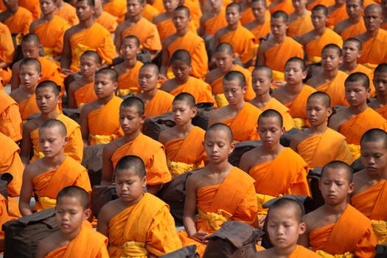
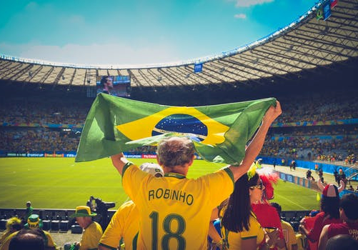
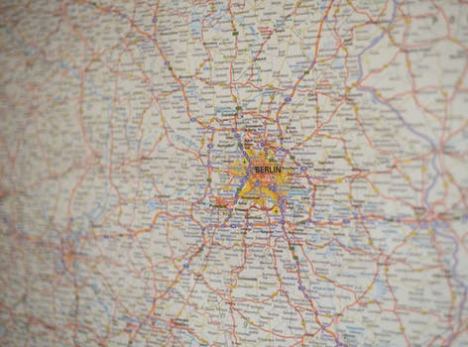
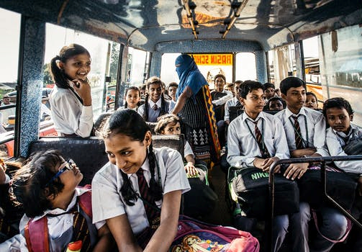
Belonging to a community
Most people belong to many different communities. These communities will be linked to your identity.
A group of people who are in close contact and who share common interests and values.
Notes:
Discuss each image. Discuss how it forms a community and how this is linked to identity. E.g. religious community, fan community (sport, music) geographical community, school community. Discuss how each are important and why some might be more important than others, but how this can vary from person to person.

Slide 4
Neighbourhood
A local area within which people live as neighbours, sharing living space and interests.
In a city this can sometimes be difficult to identify
Is it the city as a whole? E.g. London
Is it a part of the city? E.g. East London
Is it a smaller area within a part of the city? E.g. Tower Hamlets
Is it a street or particular estate?
What’s your neighbourhood?
Notes:
Discuss the concept of ‘neighbourhood’ where would your students say they are from?

Slide 5
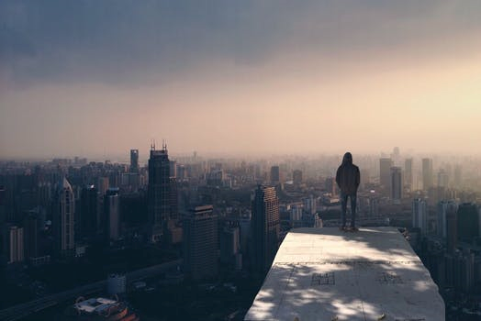
What’s your neighbourhood?
Does your neighbourhood have a positive community feel?
Is it safe and clean?
Are there things to do?
Are the people friendly?
Are there shops and other facilities?
Is your neighbourhood community important to you? Why?
Notes:
This could be done in groups so that students work with others from the same neighbourhood. Students could brainstorm responses and then discuss as a whole. Consider why and how people might have different opinions about the same community.

Slide 6
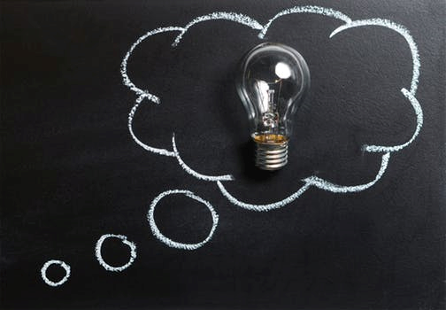
Communities can overlap and change
What communities do you belong to?
What do you gain from these communities?
Challenge - How might your communities change over time?
Notes:
Final reflection activity. This could be done individually on post its notes, in exercise books if used. Or as a final discussion.

